Slide 1

Hackathon 2025
Yousef Abugosh
Areen Mansour
Nosiba Othman
Adan Mhameed

Slide 2
Anti vs non-Antimicrobial Peptide Classification Using Computational Models
The classification of antimicrobial peptides (AMPs)
We aim to optimize AMP,
We also aim to use a light weighted model keeping relatively high classification accuracy.

Slide 3
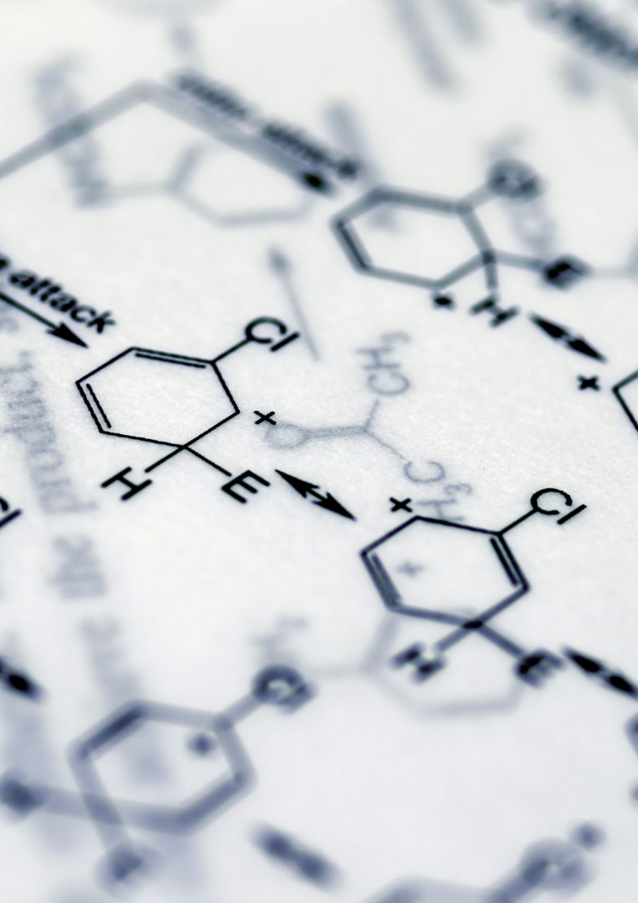
Biological Significance and Applications
Antimicrobials
Types of Antimicrobials:
Antibacterials (Antibiotics):
Antifungals:
Antivirals:
Antiparasitics:
Broad-Spectrum Antimicrobials:
Antimicrobial peptides (AMPs) hold immense significance in biology due to their versatile roles in defending organisms against microbial infections. Unlike conventional antibiotics, which often target specific pathways, AMPs exhibit broad-spectrum activity by disrupting microbial membranes, reducing the likelihood of resistance development. This makes them a promising avenue for combating multidrug-resistant bacteria, a pressing global health concern.

